Slide 1
CGB1221 – DATABASE MANAGEMENT SYSTEMS PROJECT REVIEW-2
Department of Computer Science and Engineering
Academic Year: 2024 – 2025 (Even Semester)
Register Number : 927623BCS054
Name :MADHAN G
Year : II - YEAR
Semester : IV
Section : CSE - A
Date : 7/5/2006

Slide 2
Title of the Project
GYM MEMBERSHIP MANAGEMENT

Slide 3
Abstract
A Gym Membership Management System uses abstraction to define core functionalities like User, Membership, Class, Billing, and Attendance as abstract classes. Concrete classes like Member, Trainer, and Admin inherit and implement these functionalities. This design ensures modularity, scalability, and reusability while allowing easy management of memberships, attendance, scheduling, and billing.

Slide 4
Abstract with CO/PO Mapping
Abstract | CO | POs | PSO
A Gym Membership Management System uses abstraction to define core functionalities like User, Membership, Class, Billing, and Attendance as abstract classes. Concrete classes like Member, Trainer, and Admin inherit and implement these functionalities. This design ensures modularity, scalability, and reusability while allowing easy management of memberships, attendance, scheduling, and billing. | CO -1 CO -2 CO -3 CO -4 | PO1 [2] PO2 [2] PO3 [3] PO4 [2] PO5 [3] PO6 [1] PO7 [1] PO8 [2] PO9 [2] PO1 [2] PO11 [3] PO12 [2] | PSO1 [3] PSO2 [2]

Slide 5
Introduction
A Gym Membership Management System is a software solution designed to streamline gym operations, including membership management, class scheduling, attendance tracking, and billing.
It enables members to register, renew memberships, and view schedules, while trainers and admins can manage classes and monitor attendance.
Using abstraction, the system defines core functionalities in a structured and scalable way, ensuring efficient gym management.

Slide 6
DBMS - Concepts Used
1. Entity-Relationship Model (ER Model)
2. Normalization (Up to 5NF)
3. Primary Keys and Foreign Keys
4. Normalization and Data Integrity
5. Transactions (ACID Properties)
6.Indexes

Slide 7
E-R DIAGRAM
Password
Register
Name
Role
Email
Email
Login
password
Admin
Has
User
Customer
Select_slot
View_Booking
Book_Slot
Submit
Status
Details
Add_Report
View_Report
View_report
Book_Slot
Analyze
Report
Diet_Plan
Fee_Status
Amount
Diet_Food
Status
Plan
Fee_Pay
Amount
7

Slide 8
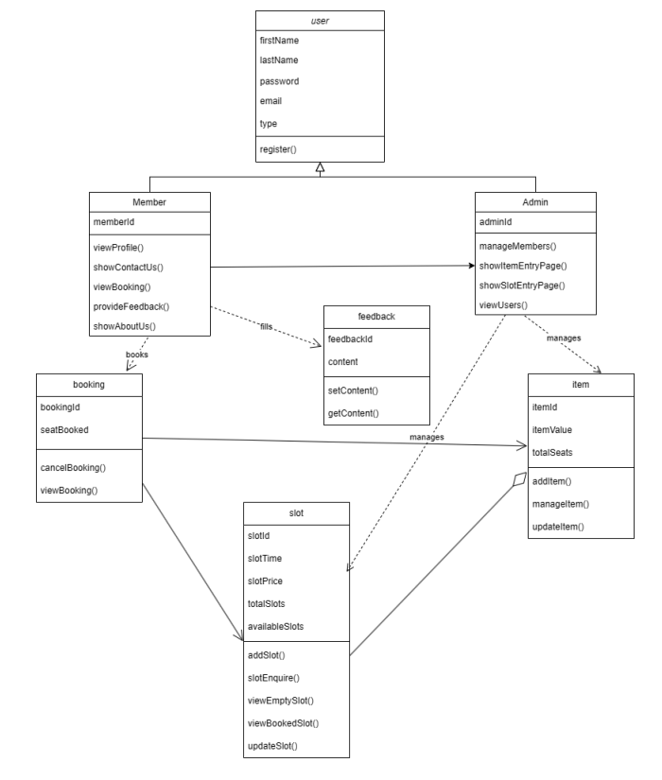
Proposed Architecture

Slide 9
Proposed Architecture - Description
LOGIN MANAGEMENT:
User Authentication: Verifying the identity of users through credentials like username and password, or more advanced methods like two-factor authentication (2FA) or biometric verification.
Access Control: Determining which parts of the system different users can access based on their roles (e.g., admin, staff, member). This ensures that sensitive information is protected and that users only have access to the functions they need.
SYSTEM USER MANAGEMENT:
User Roles: Defines different levels of access and permissions based on roles. Common roles include:
Administrators: Full control over the system, including user management, setting permissions, and overseeing operations.
Staff: Ability to manage member details, track attendance, schedule classes, and handle billing.
Members: Can log in to book classes, view schedules, update their information, and make payments.

Slide 10
List of Modules
1. User Management Module
2. Membership Management Module
3. Class Scheduling Module
4. Billing & Payment Module
5. Notifications & Reports Module

Slide 11
Module Description
1. User Management Module:
- Manages user registration, login, and authentication.
- Allows role-based access control (admin, trainers, members).
- Stores user profiles with personal details, contact information, and preferences.
- Provides account management features (update profile, password reset, etc.).
2. Membership Management Module:
- Handles different membership plans (monthly, yearly, VIP, etc.).
- Allows users to purchase, renew, or cancel memberships.
- Tracks membership expiration dates and sends renewal reminders.
- Provides access control based on membership type.

Slide 12
Module Description (Cont..)
3. Class Scheduling Module:
Enables trainers to create and manage class schedules.
Allows members to book, reschedule, or cancel class reservations.
Tracks attendance and availability for each session.
4. Billing & Payment Module:
- Processes payments for memberships, classes, and additional services.
- Supports multiple payment methods (credit card, UPI, bank transfer, etc.).
- Generates invoices and payment receipts.
5. Notifications & Reports Module:
- Sends automated email/SMS notifications for membership renewals, class bookings, and payment updates.
- Generates analytical reports on user activity, revenue, and attendance trends.
- Provides insights into business performance and growth metrics.
- Allows admins to customize report formats and export data.

Slide 13
Software Specification (Tools / Programming Languages used)
Front-end: HTML + CSS + JS
Back-end: XAMPP

Slide 14
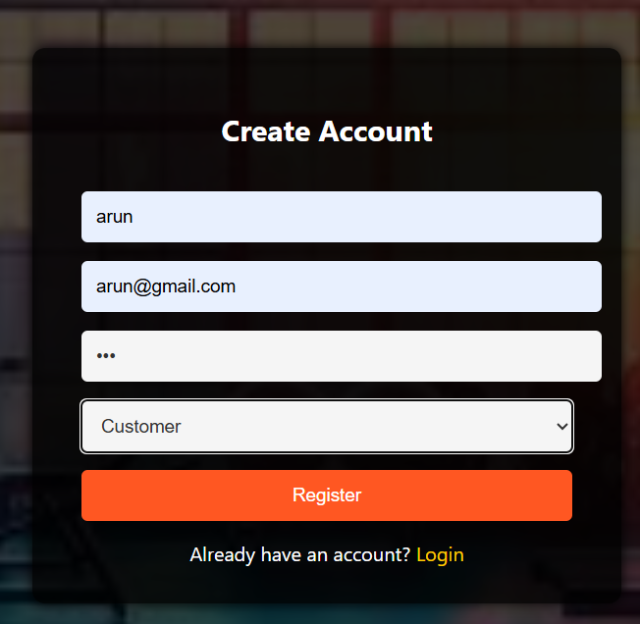
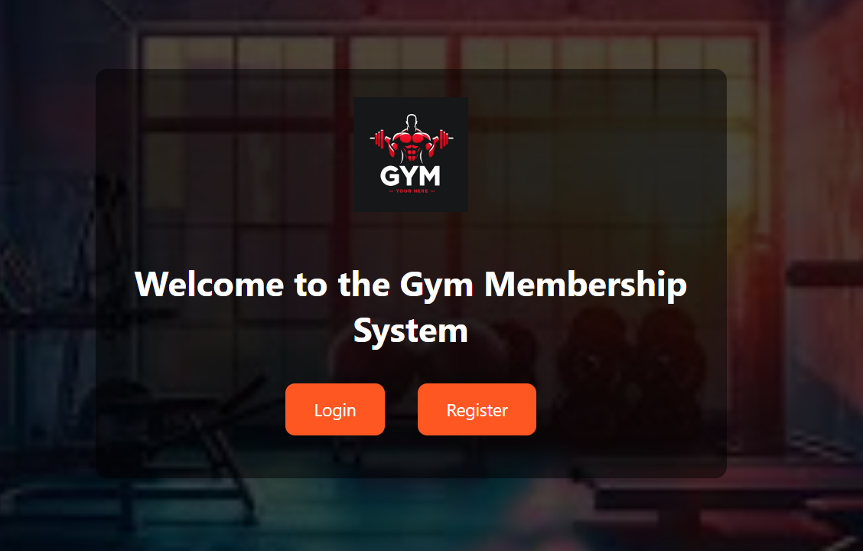
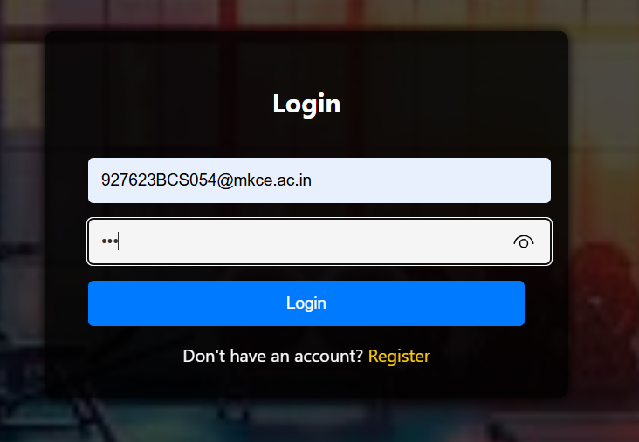
Sample Screen shot
REGISTER AND LOGIN:

Slide 15
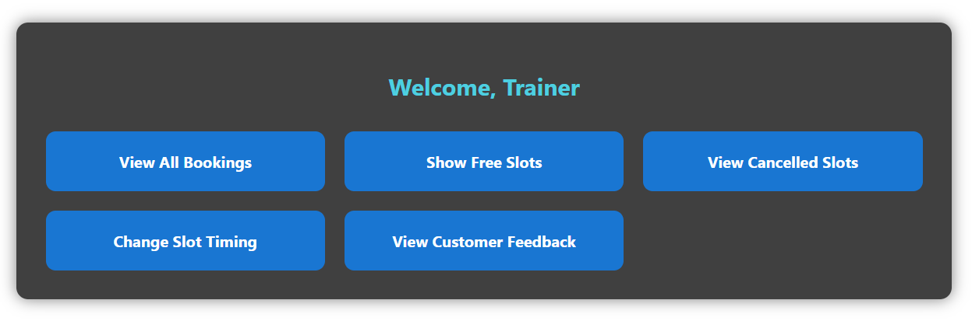
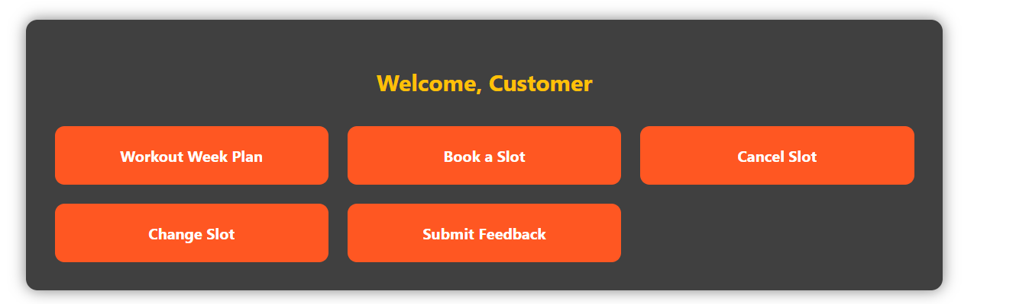
Sample Screen shot

Slide 16
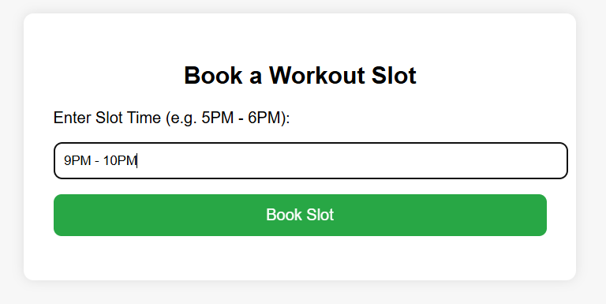
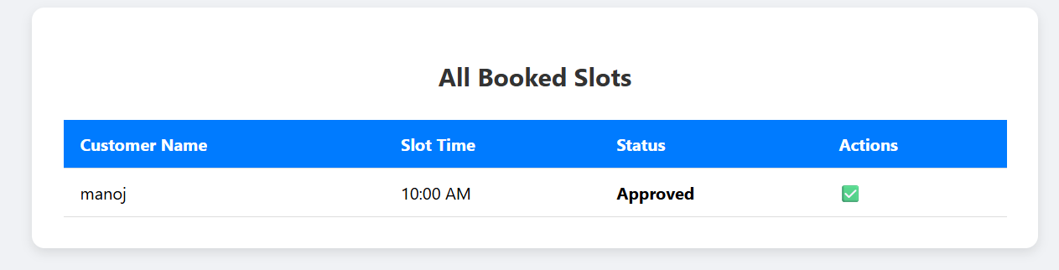
Sample Screen shot
REQUEST FOR THE SERVICE:

Slide 17
Conclusion
By implementing these modules effectively, our system enhances automation, accessibility, and data-driven decision-making. Refining security protocols, optimizing database efficiency, and improving UI/UX can further elevate your project into a robust gym management solution adaptable to future scalability and innovation .

Slide 18
Thank You
Any queries???

